Slide 1
GI
Mucositis
Diarrhea

Slide 2
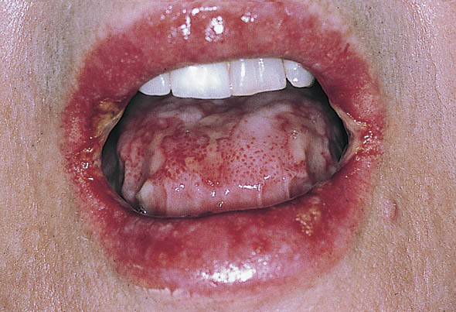
Mucositis
Drugs that cause Mucositis | 5-FU Anthracycline Cytarabine Methotrexate Taxanes
Occurs | 1 week after chemo
Hold chemo for | 1 – 3 weeks until mucositis heals
Tx Mucositis | Magic Mouth Wash Maalox Benadryl Lidocaine 2% Nystatin Steroids
Reduce chemo dose by | 25%
mucositis

Slide 3
Diarrhea
Drugs that cause Diarrhea | 5-FU Irotecan
Occurs | Anytime after therapy
Hold chemo | Until full recovery
Tx Diarrhea | Loperamide 4 mg PO now then Loperamide 2 mg PO q2h
Reduce chemo dose by | 25%

